Slide 1
Cluster Pipeline Execution and Analysis

Slide 2
Agenda
Workflow overview
Jenkins pipelines execution
Use Sirloin for pipeline testing
Test results analysis

Slide 3
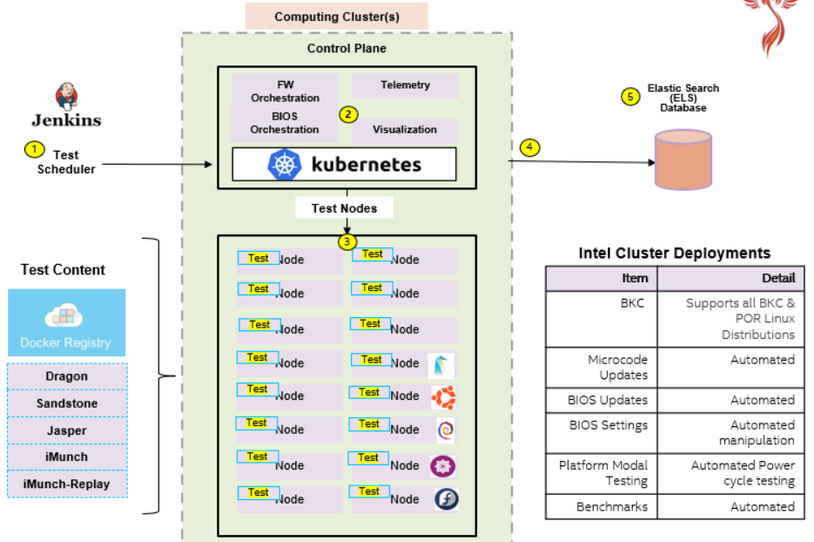
Workflow Overview

Slide 4
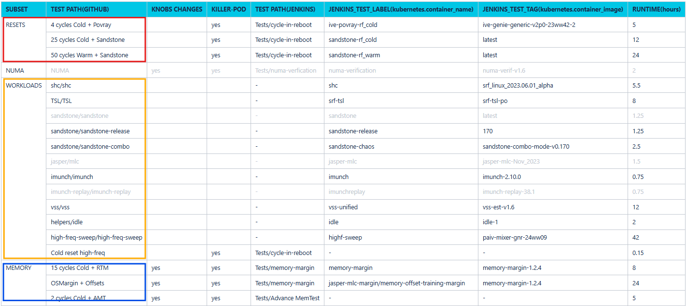
Pipelines Definition – Take Burnin as Example

Slide 5
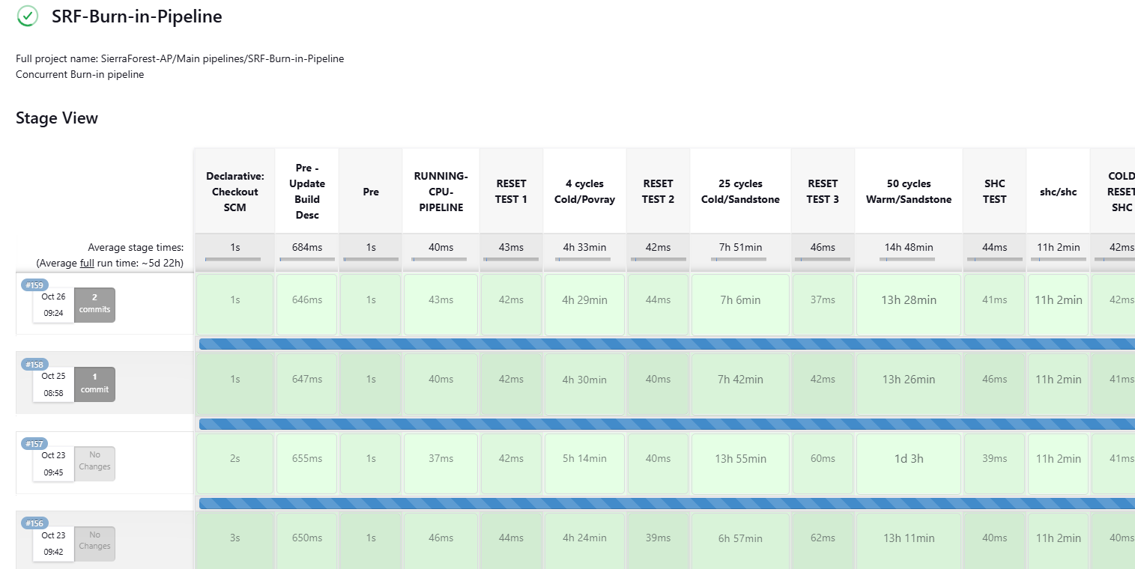
Jenkinsfile

Slide 6
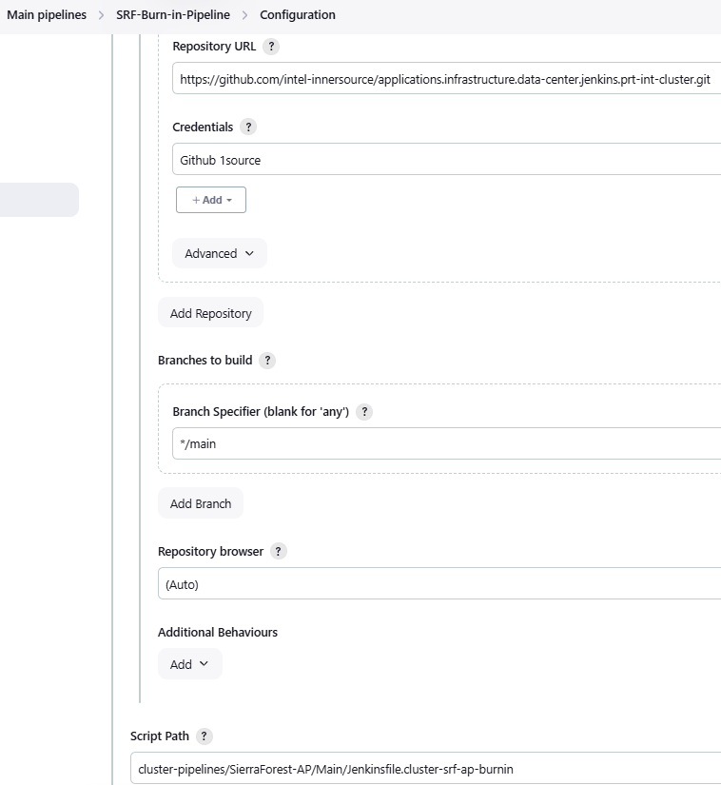
Configure a Pipeline
Pipeline configuration in Jenkins
Connect Jenkins with Github.
Specify script path in Github for this pipeline to run.

Slide 7
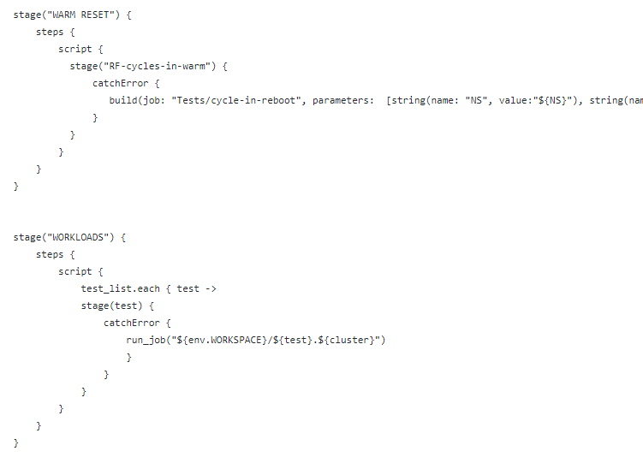
Configure a Pipeline
Pipeline definition (Jenkinsfile) in Github
In Jenkinsfile, we define tasks to be performed in each stage.
2 different tasks:
Test contents: sandstone, shc, …
Help functions: Reboot, xmlcli, …

Slide 8
Select Nodes to Run Tests
Label the worker nodes which we are going to run tests against.
Add label: kubectl label node fl31ca303as0502 srf-ap-burnin-at-ww43-6=true
Create namespace: kubectl create ns srf-ap-burnin-at-ww43-6

Slide 9
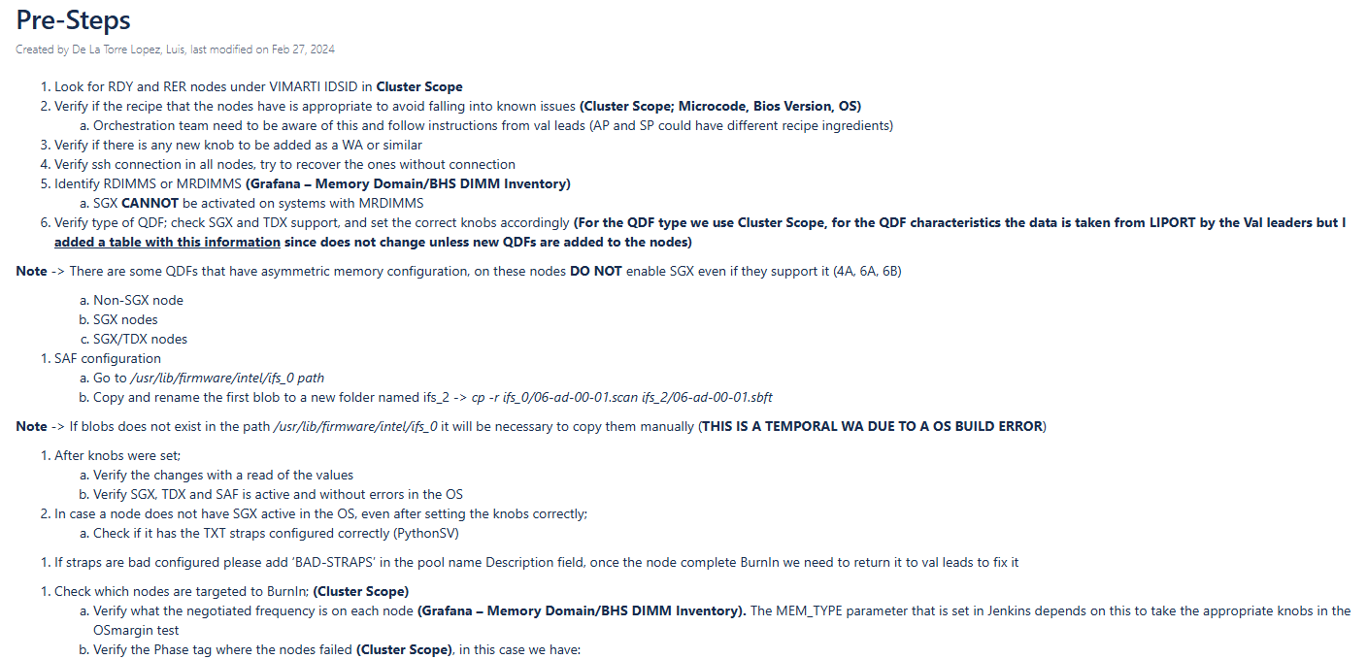
Before Starting a Pipeline

Slide 10
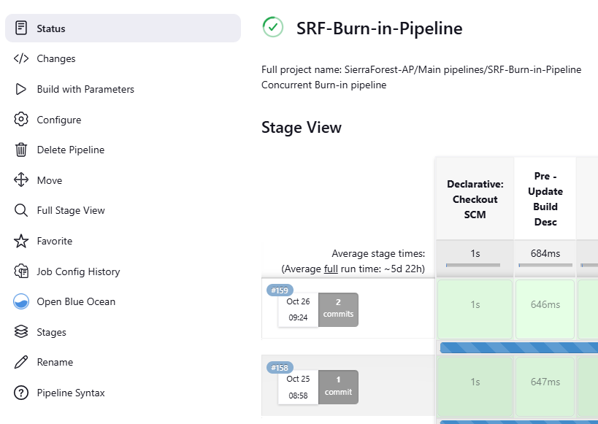
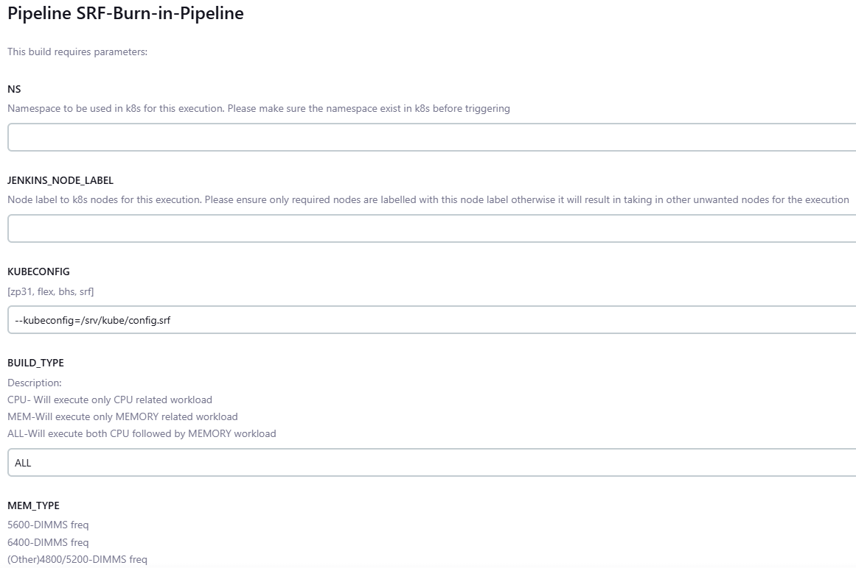
Start a Pipeline

Slide 11
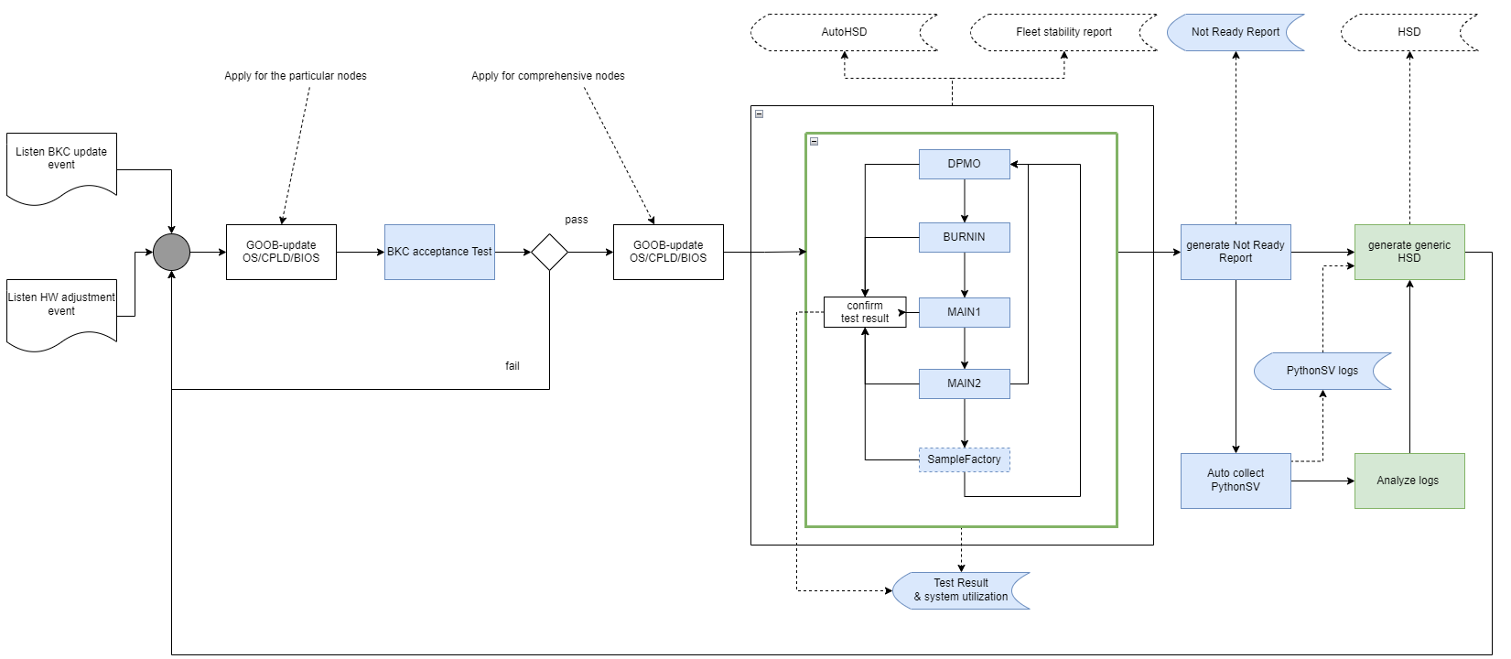
Sirloin goal : ValidationOps using automated operation flow w/o man-involved
other teams
data flow
complete
WIP
https://wiki.ith.intel.com/display/ScaleCluster/ValidationOps

Slide 12
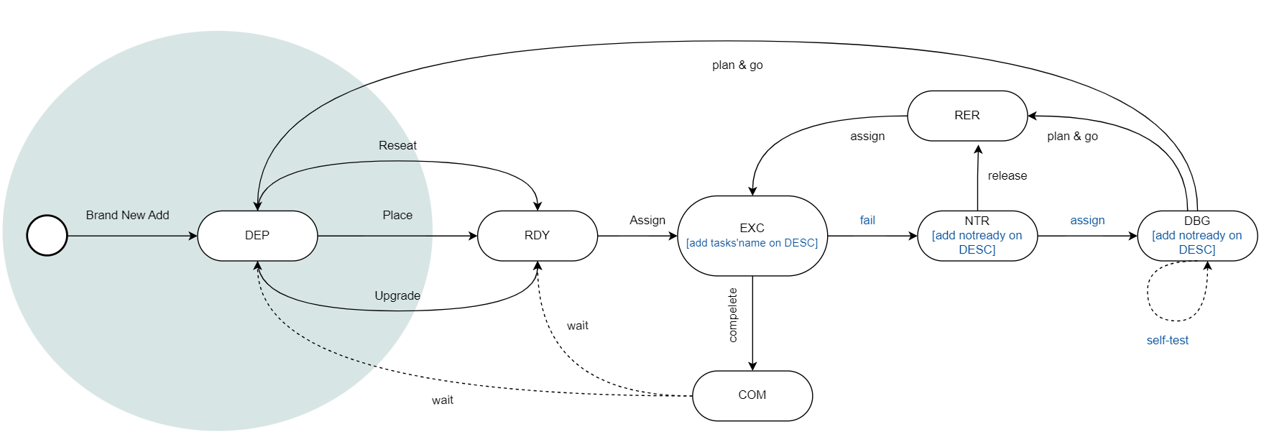
What’s our validation cycle : a node state transition

Slide 13
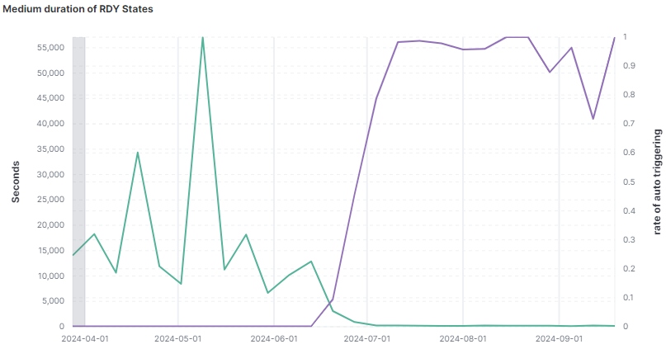
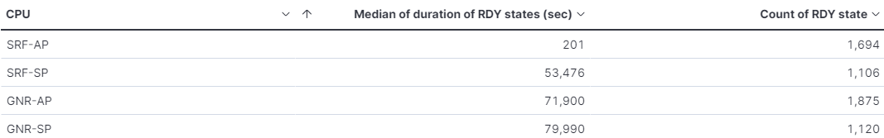
Speed up validation by automated operation flow
Duration of RDY states while AutoTrigger is applied
Significant speed-up achieved:
340x in READY states
0 waiting time for PythonSV collection
Apply rate
19 hours
201 seconds
Duration
Potential speed-up:
215x in COMPLETED states
233x in RE-RUN states
No time will be wasted creating
manual HSDs for not-ready nodes. (Save 4 hour/day/triage team)
The statistics is based on the data from 7/15-9/23

Slide 14
Speed-ups by pool states
233x
340x
215x

Slide 15
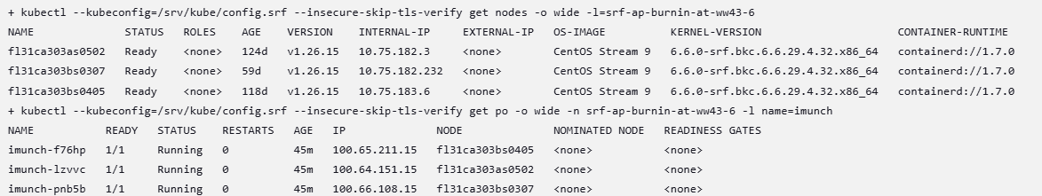
Jenkins Console Outputs
One of the challenge is to monitor pod running status in each stage of pipeline.
Traditional way is checking console output of the pipeline, search the pod name, and check pod running status one by one.

Slide 16
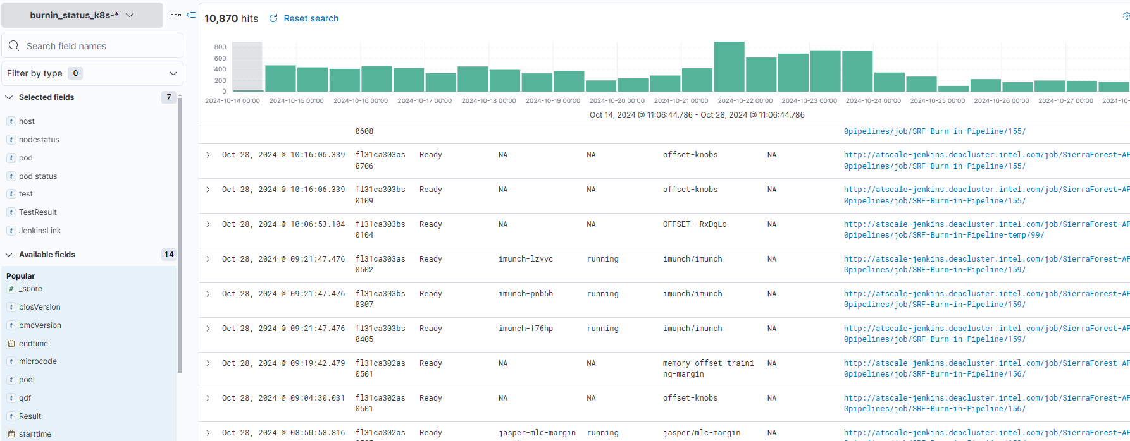
Kibana – Pipelines Results

Slide 17
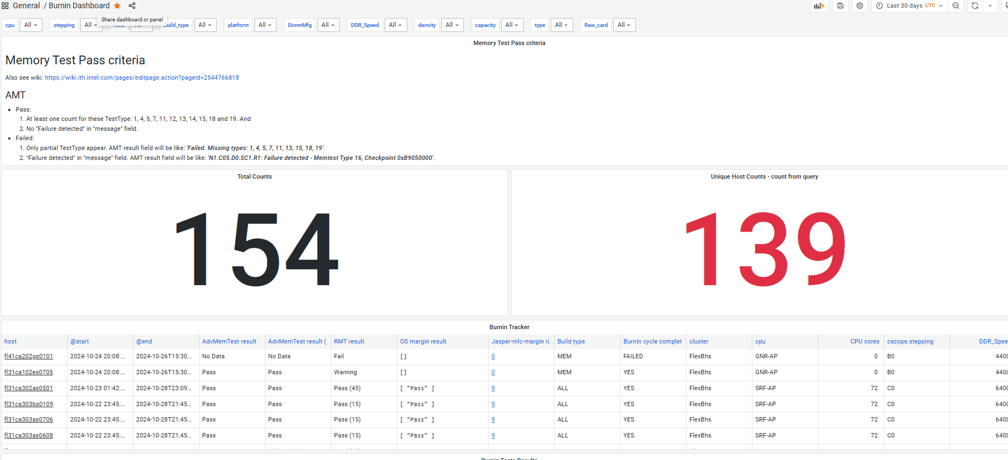
Memory Tests Tracker

Slide 18
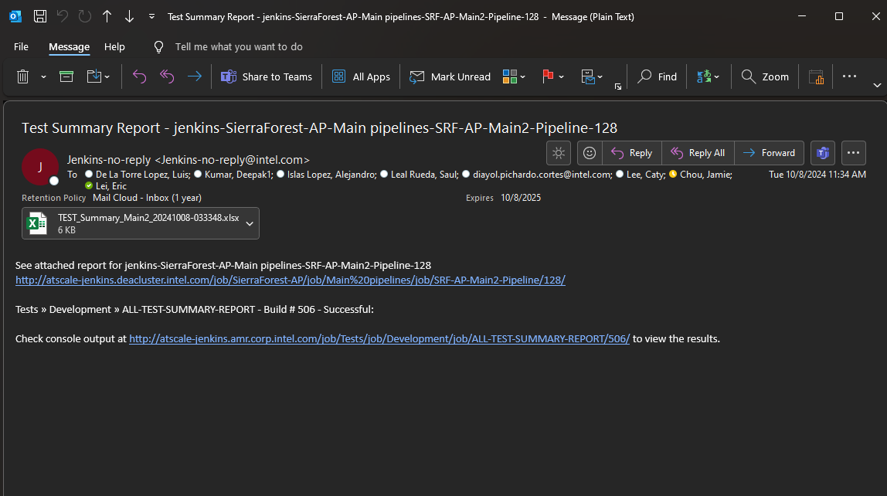
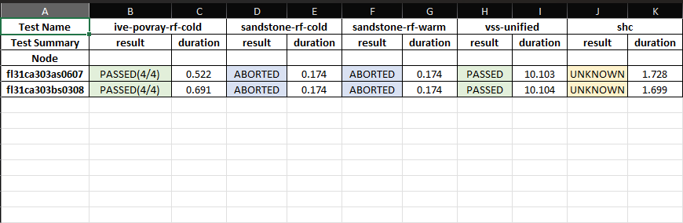
Test Summary Reports
Kibana
Jenkins
K8s

Slide 19
Reference
Pipelines definition: https://wiki.ith.intel.com/pages/viewpage.action?pageId=3431182538
Jenkinsfile: https://github.com/intel-innersource/applications.infrastructure.data-center.jenkins.prt-int-cluster/blob/main/cluster-pipelines/SierraForest-AP/Main/Jenkinsfile.cluster-srf-ap-burnin
Kibana for pipelines results: http://kibana.zp31k1.deacluster.intel.com:5601/goto/e033cd00-94d9-11ef-8294-1f5ffd6c05bf
Grafana for memory tests results: https://grafana02.jf.sova.intel.com/goto/lAycupZNk?orgId=1

Slide 20
Backup

Slide 21
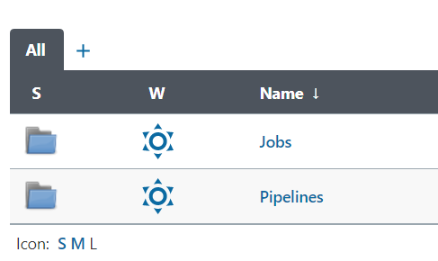
Work Items in Jenkins
A Jenkins Pipeline is a user-defined pipeline composed by different stage.
A Job is a Freestyle project in Jenkins.

Slide 22
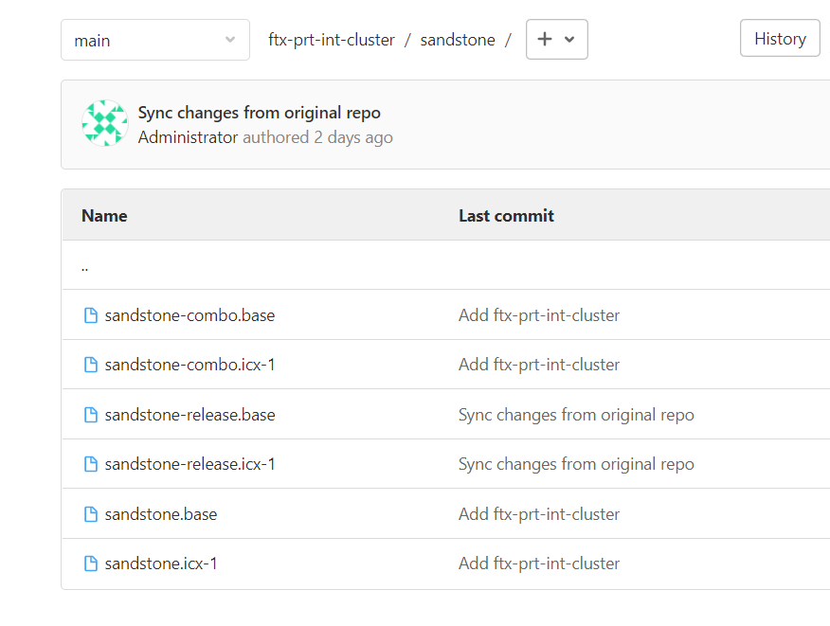
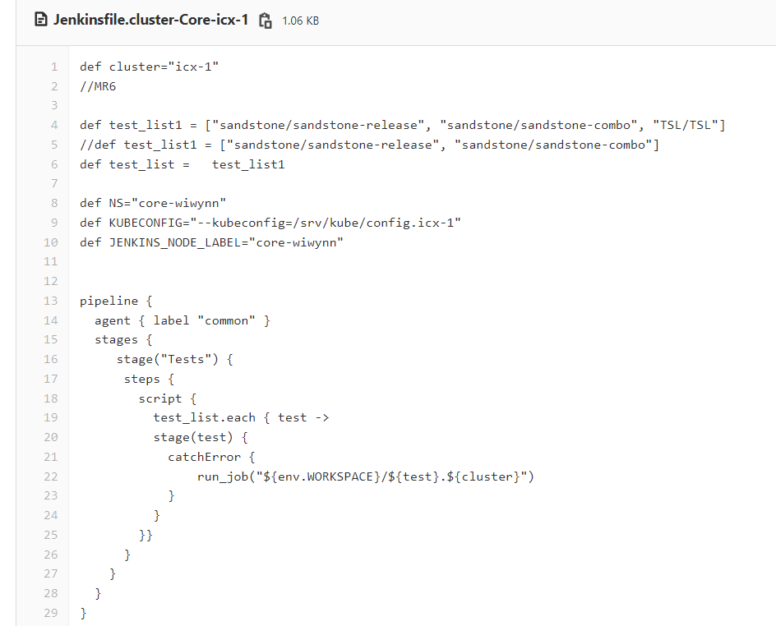
Configure a Pipeline
Take “sandstone/sandstone-release” in Gitlab as example

Slide 23
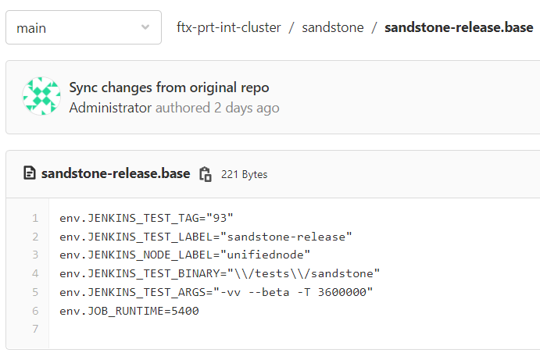
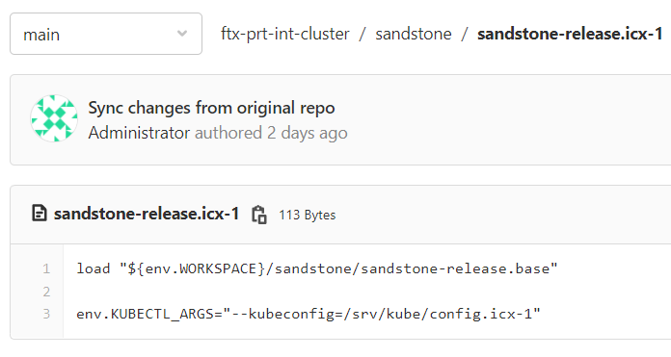
Configure a Pipeline
In Gitlab

Slide 24
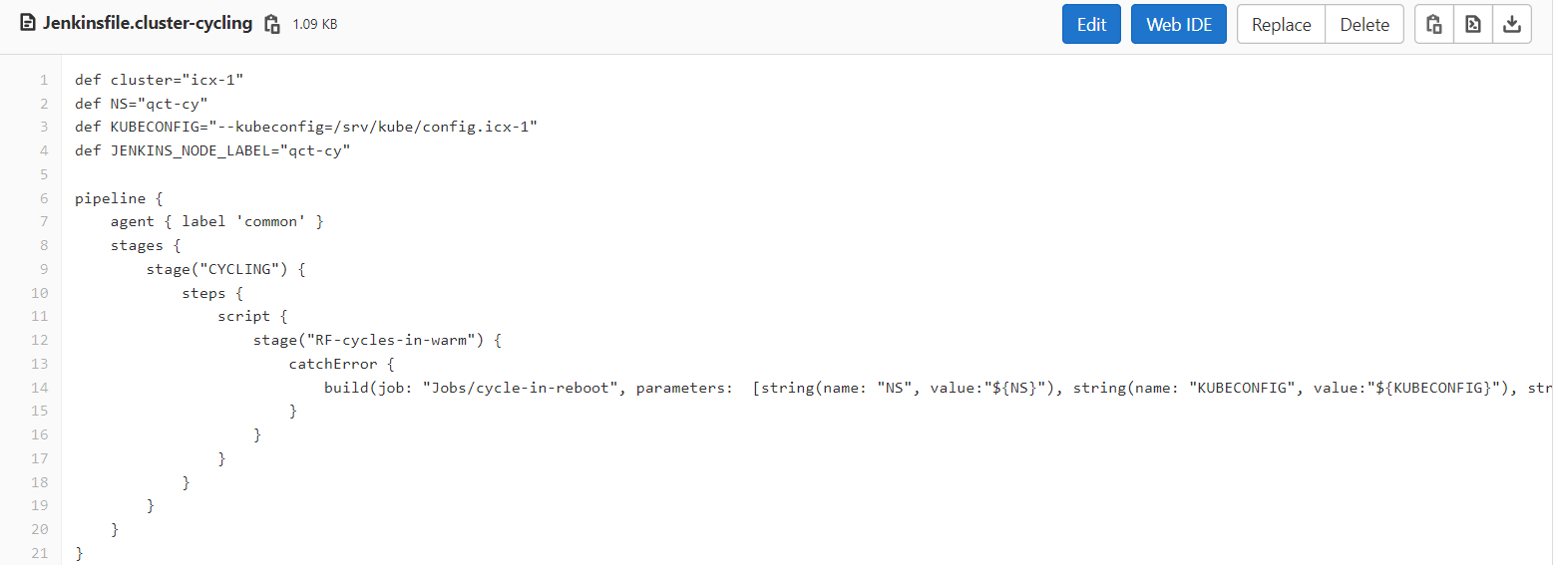
Configure a Job
In Gitlab

Slide 25
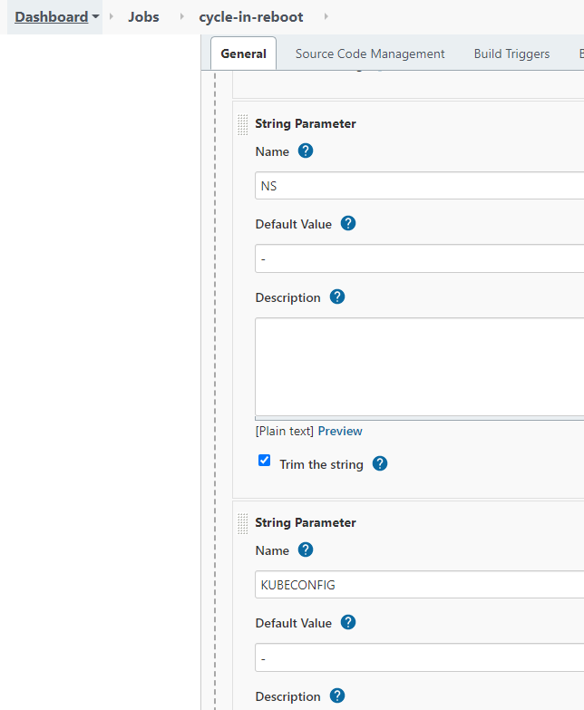
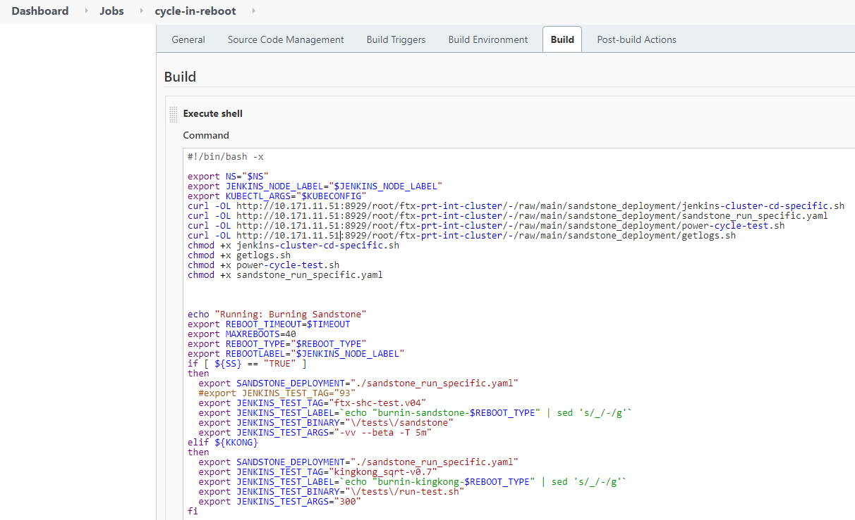
Configure a Job
In Jenkins

Slide 26
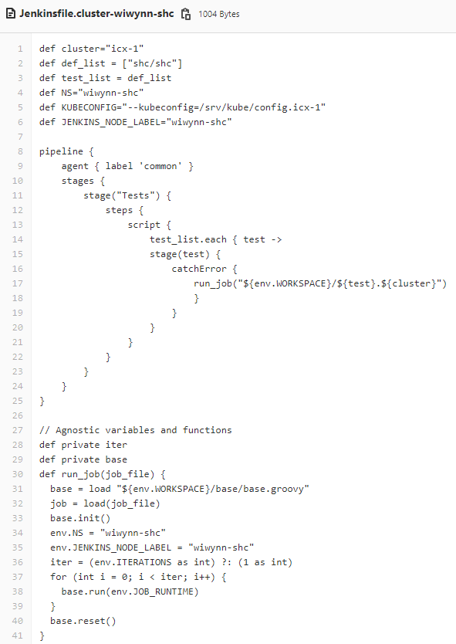
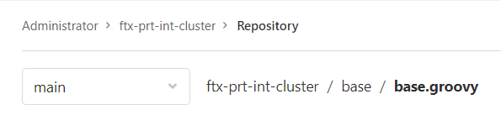

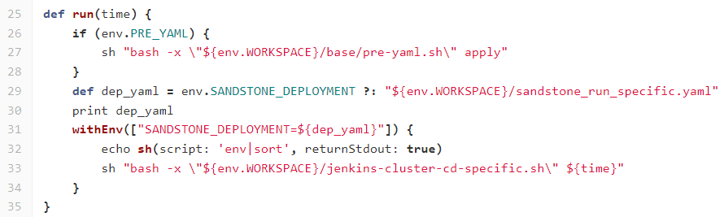
Start a Pipeline

Slide 27
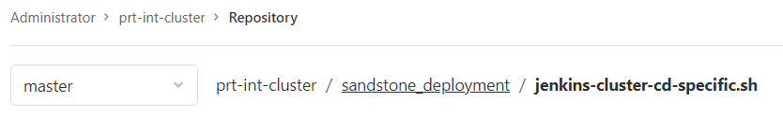
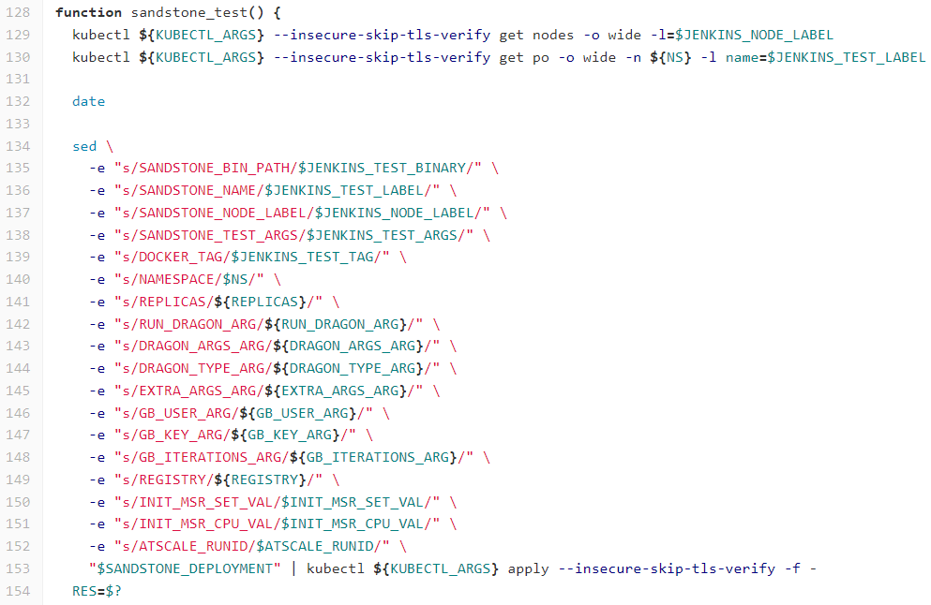
Start a Pipeline
sandstone_run_completed.yaml
To create DaemonSet and run test on each SUT in cluster.

Slide 28
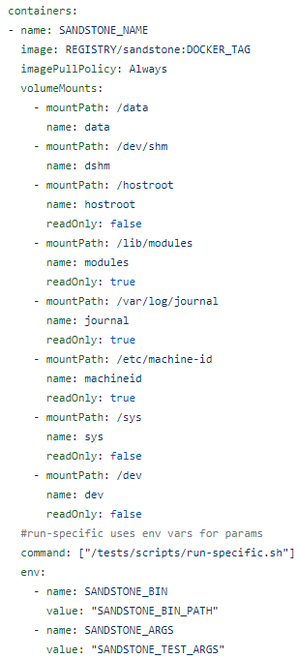
Start a Pipeline
sandstone_run_completed.yaml
All images are named as “sandstone”.
Use tag to tell which image should be deployed.
"/tests/scripts/run-specific.sh“ is the entry point to start execution.
Value of $SANDSTONE_BIN & $SANDSTONE_ARGS are passed in during run time.

Slide 29
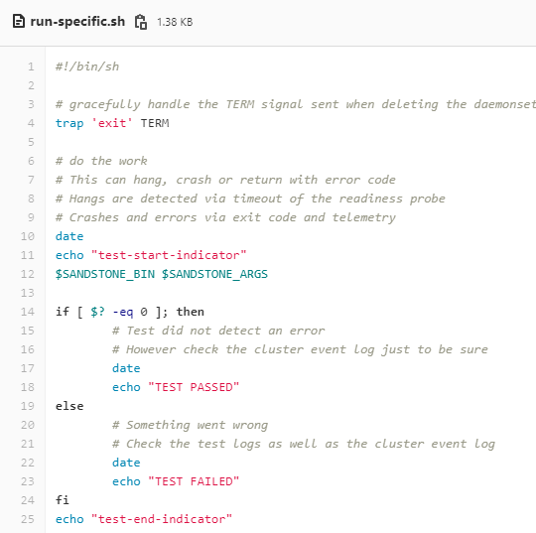
Parameterized command
$SANDSTONE_BIN & $SANDSTONE_ARGS
You don't need to rebuild image for different command and parameters.

Slide 30
Build separate image for each tool
Different tool might have different dependency. To keep image as thin as possible, better to separate different images.
Docker image size might impact network bandwidth
ive-mixer-spr-xxx
https://wiki.ith.intel.com/pages/viewpage.action?pageId=2121206941
Counter example: SHC

Slide 31
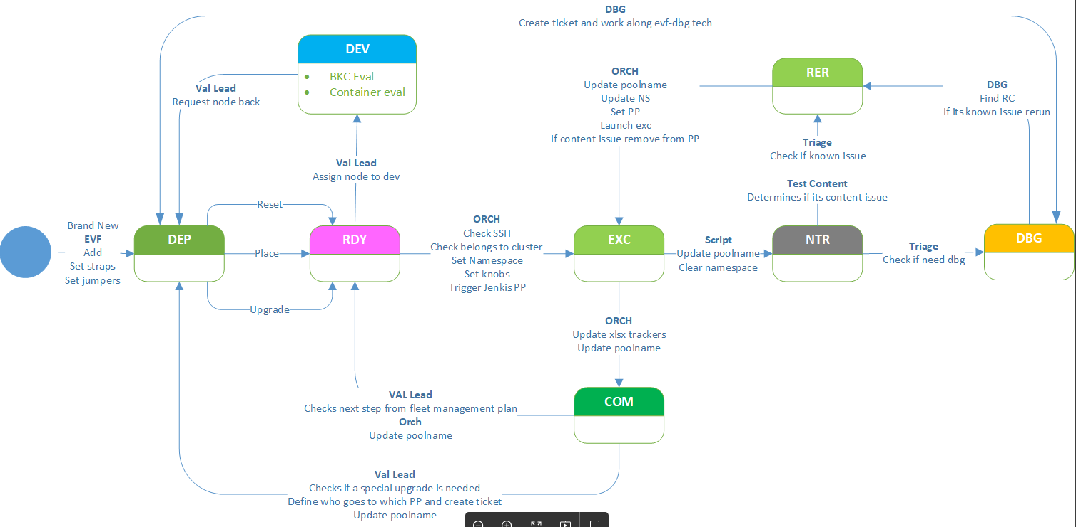
Cluster Scope - State Transition

